Slide 1
Income Inequality in the United States, 1913-1998
Thomas Piketty and Emmanuel Saez

Slide 2
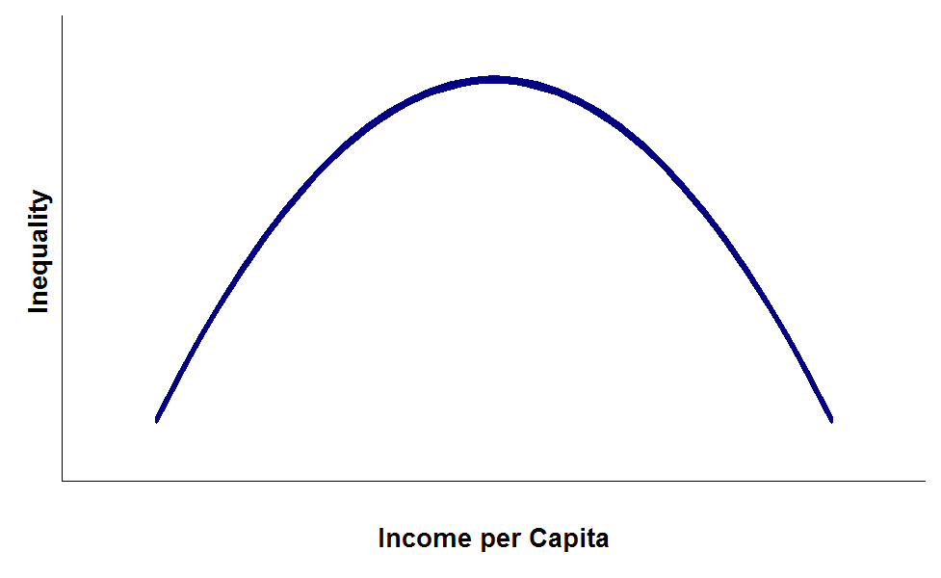
Kuznets’ inverse-U curve
widening inequality in the early phases of economic growth.
narrowing inequality in the later phases of economic growth.

Slide 3
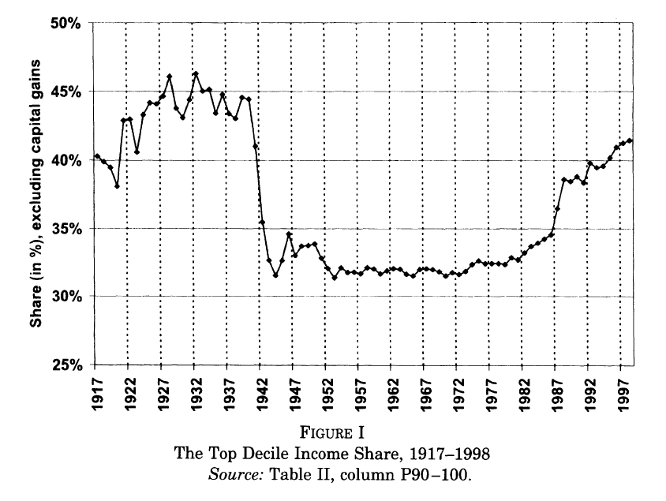
Income inequality in the United States

Slide 4
Question to this inverse-U curve
How to measure income inequality
Top income share of total income. Including capital income, wage income.
Fact:
A falling inequality in first half of the twentieth century.
In 1970s, there exist a sharp increasing in income inequality.

Slide 5
Data and Methodology
Data based on tax units. (often a household)
The time series pattern of top shares based on individuals should be very similar to that based on tax unit.

Slide 6
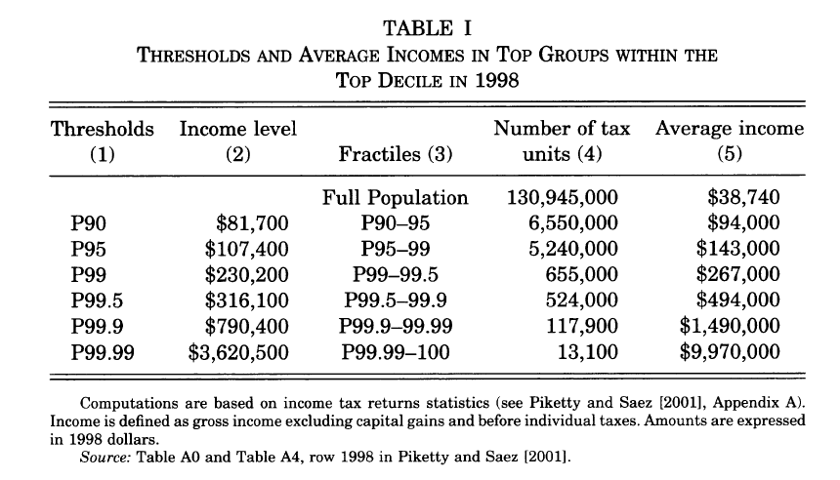
Data and Methodology

Slide 7
The Composition of income
Capital income
(including dividends, interest, rents, and royalties)
Wage income
(including wage, salary, stock option)
We will analyze the top income share into three categories P90-95, P95-99, and P99-100 first.
Then analyze the change of capital income and wage income in these three categories.

Slide 8
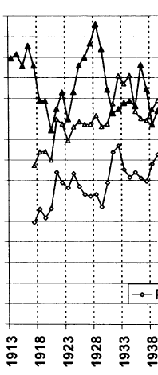
Trends in Top Income Shares
P99-100
During 1917-1939, this figure shows that the fluctuation of shares for P90-95 and P95-99 is exactly opposite to the fluctuation for P99-100.
P90-99 incomes are mostly composed of wage income.
P99-100 incomes are mostly composed of capital income.
P95-99
P90-95

Slide 9

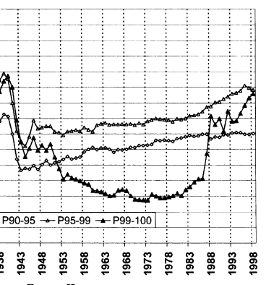
Trends in Top Income Shares
Drop: Increasing tax to finance the war.
Surge:
Increasing in wage income.
P95-99
P90-95
P99-100

Slide 10
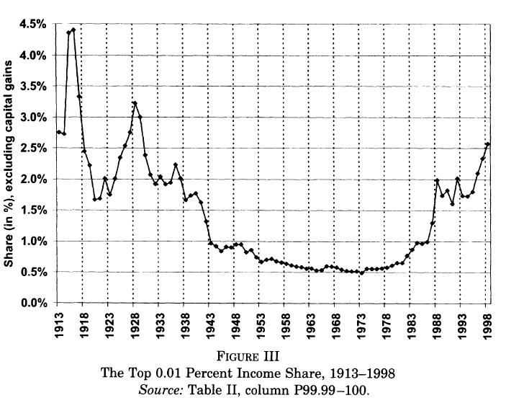
Effect of TRA86
Decreasing individual income tax rates, while increasing corporate taxes, capital gains taxes.
Effect of TRA86:
No permanent surge in top shares.

Slide 11
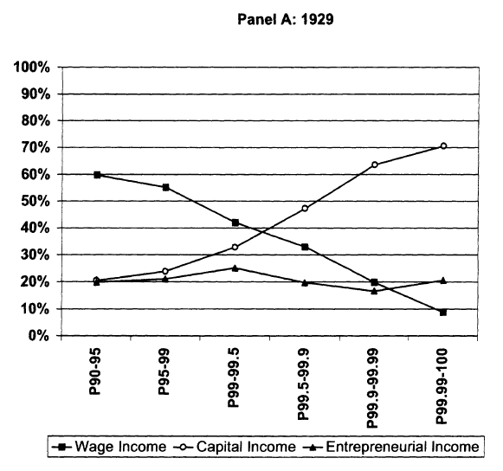
The secular decline of top capital incomes
In 1929,
With increasing of income, we have:
Capital income increasing
Wage income decreasing
Entrepreneurial income fairly flat.
(self-employment, small businesses, partnerships)

Slide 12
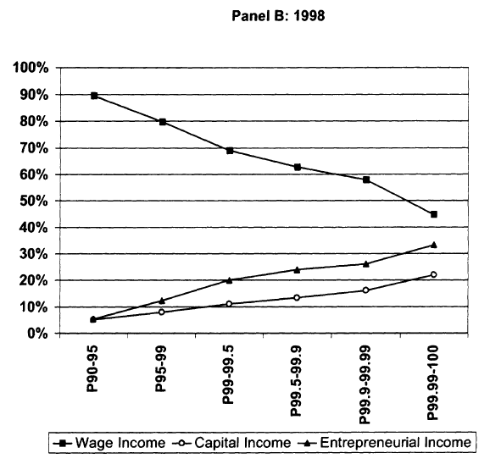
The secular decline of top capital incomes
In 1998,
With increasing of income, we have:
Capital income increasing
Wage income decreasing
Entrepreneurial income increasing

Slide 13
Some important questions in these two figures
Why capital income shares drop in all top share tax unit from 1929 to 1998.
Why wage income shares increasing from 1929 to 1998.

Slide 14
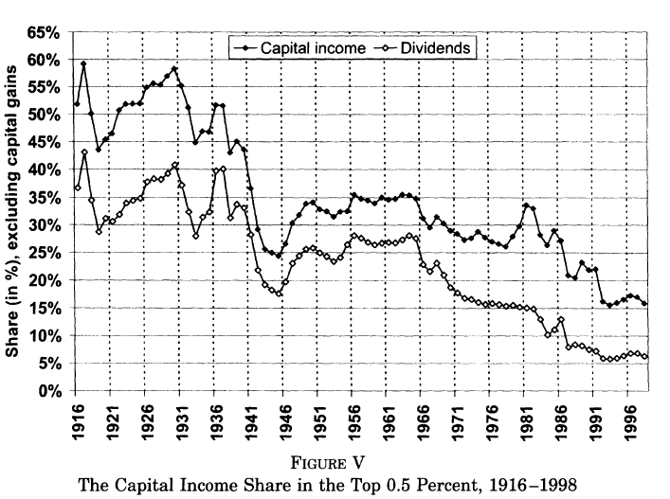
The dramatic evolution of the capital income in top incomes
Sharp decreasing occurred at World War I, The Great Depression and World War II.
The decreasing of capital income is entirely due to dividends, not interest, rent, and royalties.

Slide 15
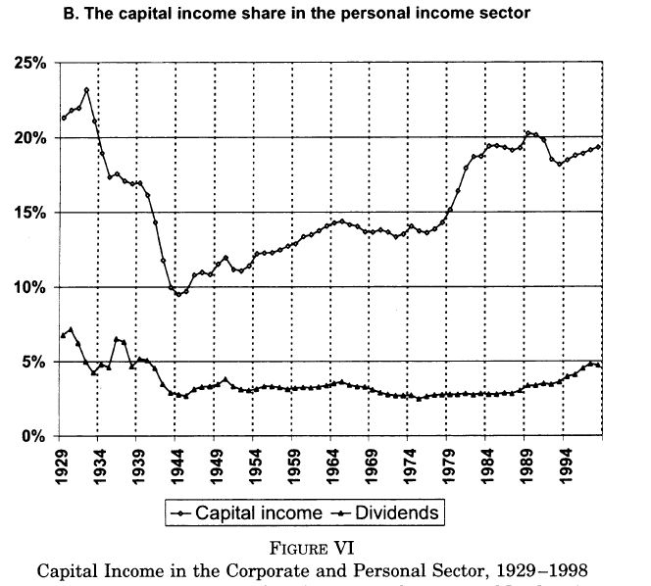
Decreased concentration of capital income rather than a decline in the share of capital income in the economics as a whole.

Slide 16
Reason of decreasing concentration of capital income.
Macroeconomic shock of the Great Depression.
Fiscal shock of two world war.
The same value of top real estate in 1916 and 1997.

Slide 17
The role of progressive taxation
Including progressive estate tax and progressive corporate income tax.
A very high marginal tax rate created a substantial burden on the very top income groups.
A dynamic effect of tax, reduces the net return on tomorrow.

Slide 18
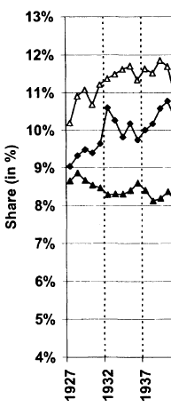
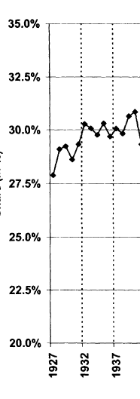
Top Wage Shares: Before World WarⅡ
P95-99
Top wage share of P90-100 quite stable before the second world war.
P90-95
P99-100
P90-100

Slide 19

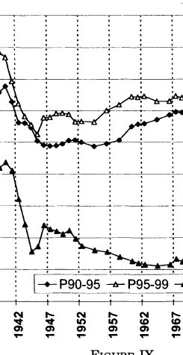

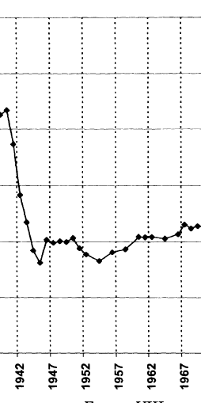
Top Wage Shares: Sharp drop in Inequality During World WarⅡ
Wage control of war economy.
And didn’t recover after the end of war.
Overall drop in top wage shares is significant lower than the overall drop in top income shares.
P95-99
P90-95
P99-100
P90-100

Slide 20


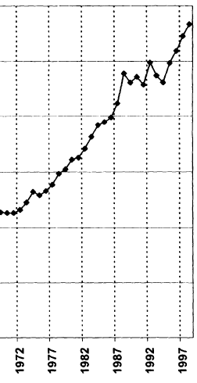
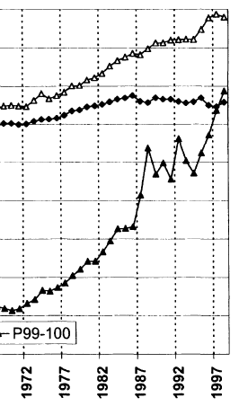
The Increase in Top Shares since the 1970s
Short term effect of TRA86.
Technology change in 1970s.
Development of stock options that are reported as wages and salaries income.
P95-99
P90-95
P90-100
P99-100

Slide 21
Why didn’t wages recover after the end of war?
Some market and nonmarket mechanisms cause this.
high marginal wage tax rate, discourage corporations from increasing top salaries.
Redistributive policy reforms.
Increasing unionization.

Slide 22
Conclusion
Top capital incomes shares keep decreasing over the century.
Top wages income shares drop during the Second World War, and increasing after 1970s.
Top incomes shares, including capital income and wage income, show a U shape over the century.

Slide 23
Reasons in terms of capital income
The Great Depression destroyed many businesses, reduce top capital incomes
The Second World War generated large fiscal shocks, reduce incomes of stockholders.
Decreased concentration in capital income.
Progressive taxation.
Top capital income never fully recover.

Slide 24
Reasons in terms of wage income
Top wage income decline in the second world war and increasing after 1970s, but never recover. This trend can be explained by some nonmarket mechanisms.
Wage control of war economics, unionization, redistribution reform cause decreasing in the middle of 20th century.
TRA86, Technology change cause increasing after 1970s.

Slide 25
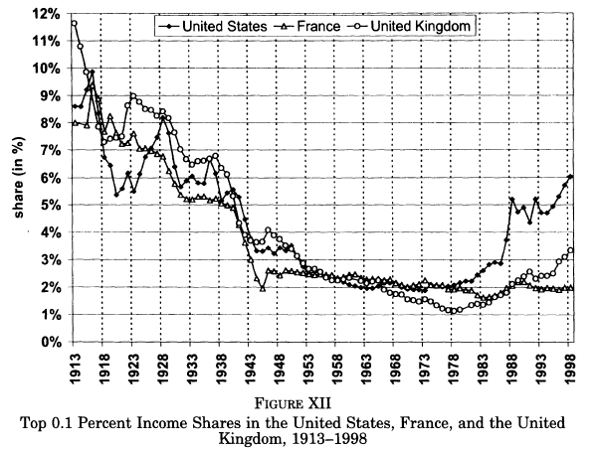
Income inequality in French and British

Slide 26
Income inequality in French and British
The impact of the second World War is larger in UK and France because the war in Europe destroy some physical capital.
Long lasting of war compression cause the increasing in inequality in the US, not in France.
An increasing in wage income in the US also enlarge the income distance between France and the US.

Slide 27
Thank You

